Slide 1

General meeting 6/10 2022
Sjur Beyer

Slide 2
Overview

Slide 3
The Git environment
I changed from using Otokens to having a SSL based git connection. If you are added as a contributor, you should add a SSL key to your github account if you want to clone the repository.

Slide 4
Current status for the models
I have ran some 1D reconstruction models;
Focusing on getting good procedures for running the models on the servers
Profiling:
I did not get very good results for running on Odin. My laptop performed better; Probably because tf ran things in parallel on the laptop graphics processor (much better parallel compute)

Slide 5
Plan
Running models - meanwhile writing theory
Depending on results change things underway

Slide 6
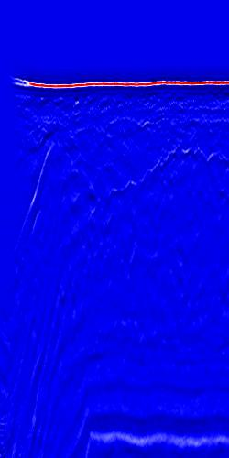
Data cleaning
The left-most side of the image contains some anomalous data which can throw off the ML training
These traces should be removed from the data set

Slide 7
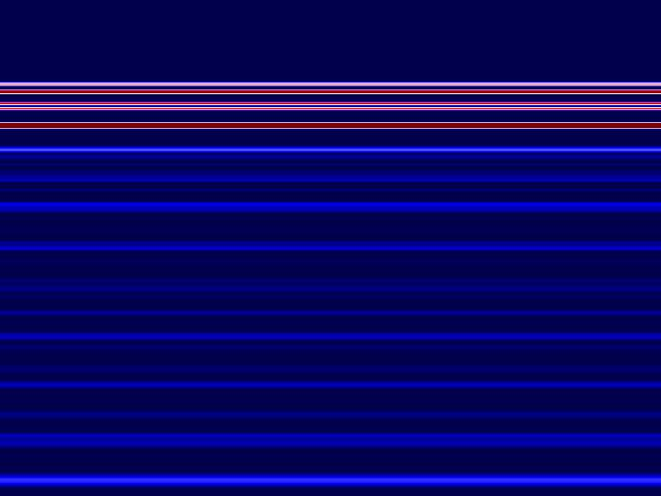
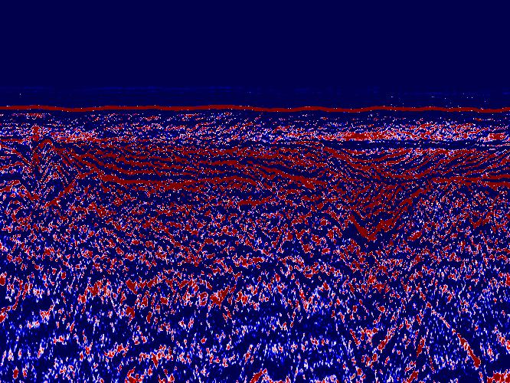
Initial results
Testing out reconstructing the seismic data with 1D TCN
Model converges to some sort of average
NB! These plots are not normalized
Config:
nb_filters = 64
Kernel size = 3 ( which may explain a lot)
Dilations = [1, 2, 4, 8, 16]
batch_size = 20
Epochs = 10
Loss approx. 3

Slide 8
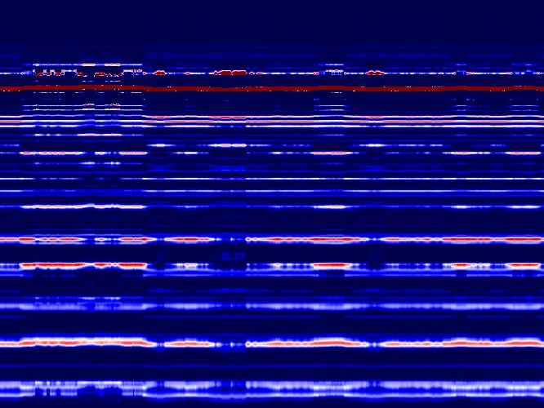
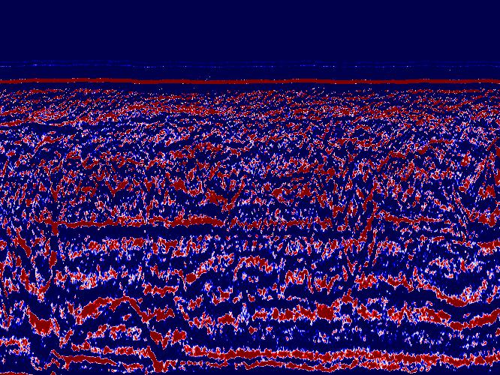
2nd try
This one was able to capture the ocean bottom reflector pretty well.
Config:
nb_filters = 64
Kernel size = 8
Dilations = [1, 2, 4, 8, 16, 32]
batch_size = 20
Epochs = 10
Loss = 1.28

Slide 9
Misc
Causal padding is not supported for Conv2D
Discussion around this

